Slide 1

TOPIC #9
EECE 490 -INTRODUCTION TO MACHINE LEARNING
COUNTER SPEECH & SPEAKER RECOGNITION
Group: Theana Mansour, Talia Semaan, Titia Saikali, Maryam Abou Merhi

Slide 2

I) PROJECT OVERVIEW
WHAT IS SPEECH RECOGNITION?
Recognize and analyze human speech: converting speech into texts commands that a computer can comprehend.
Captures audio, analyzes the sounds and matches them to words or phrases in its database.
Common usages: speech-to-text, voice commands to smart devices, etc
WHAT IS SPEAKER RECOGNITION?
Biometric technology
Identifies a person based on their unique vocal traits.
Analyzes how it’s said: looking at vocal tract structure and speaking habits.
Compares features: pitch, intensity, duration, and frequency patterns to determine who is speaking
Both technologies
Analyze different aspects of audio signals (content or identity) to produce accurate results.
Raises privacy concerns: conversations can be automatically transcribed or speakers identified without consent.

Slide 3
II) RESEARCH: ASR

Slide 4
WHAT IS ASR?
Automatic Speech Recognition (ASR)
Converts spoken language into written text.
Powers everyday tools (Siri, Google Assistant, dictation apps, auto-captioning, and call-center transcription)
Core technology for natural human-computer interaction
Improves accessibility, education, healthcare, and customer service.

Slide 5

HOW DOES ASR WORK?
AUDIO AND REPROCESSING
FEATURE EXTRACTION
ACOUSTIC/ENCODER MODEL
LANGUAGE MODEL AND DECODING
A microphone captures speech as a digital waveform. The system then cleans the signal by removing noise, trimming silences, and normalizing volume.
Raw audio is hard to process, so the system extracts features like Mel filterbanks and MFCCs, which capture how sound energy spreads across frequencies over time.
These features are fed into a model, older ones used HMM-GMM, while modern systems use neural networks like LSTM or Transformers, to predict speech units over time.
The system uses a language model to choose the most likely words, combining it with acoustic data to produce the final text.

Slide 6
MACHINE LEARNING MODELS FOR ASR
1) TRADITIONAL HYBRID SYSTEMS (GMM-HMM AND DNN-HMM)
For many years, ASR systems were built as hybrid models.
They separated the problem into an acoustic and language model
Goal: find the word sequence W that maximizes
P(W│X) ∝ P(X│W) P(W)
2) END-TO-END ASR
CTC models: simple, good for streaming, needs LM in decoding
Attention-based (LAS): encoder-decoder with attention, strong accuracy
Transformers / Conformers: state-of-the-art, capture global context and local structure

Slide 7
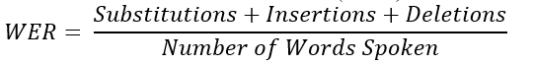
TRAINING, EVALUATION AND DATASETS
Deep ASR models need lots of labeled audio, but self-supervised models like wav2vec 2.0 or Whisper-style systems learn from unlabeled audio, then fine-tune on smaller labeled datasets.
The most common evaluation metric is Word Error Rate (WER):
Lower WER means better performance. For some languages or character-based systems, Character Error Rate (CER) is also used.
Standard datasets include LibriSpeech, Switchboard, CHiME (noisy speech), and multilingual resources like Common Voice, which allow fair comparison of different models

Slide 8
CURRENT CHALLENGES IN ASR
Background noise, overlapping speakers
Accents & low-resource languages
Real-time efficiency & latency
Fairness, privacy, and data bias

Slide 9
III) TESTING THE EFFECT OF RANDOM SOUNDS ON MICROSOFT TEAMS SPEECH DETECTION

Slide 10
METHODOLOGY
1) Using Python libraries like numpy and sounddevice, five types of sounds were generated:
White noise: random noise with values between -1 and 1
Sine wave: a tone of random frequency between 200Hz and 1000Hz
Chirp: tone that goes from a random frequency (200-600Hz) to another (1000-3000Hz)
Glitch noise: short bursts of random noise appearing at intervals to simulate erratic signals
Overlapping sine waves: sum of multiple sine waves at random frequencies to create complex harmonic sounds.
2) We also tested two human speech recordings played at the same time, overlapping on top of each other.
3) Each sound was generated for 10 seconds and played through the computer speakers using sounddevice.
4) The program randomly selected 5 sounds from the options and played them consecutively, with a short pause in between
5) While the sounds were playing, Microsoft Teams transcription was active. We observed whether Teams could still detect speech or whether the sounds interfered with detection

Slide 11
OBSERVATIONS
1
2
3
White noise fully blocked transcription. White noise hasa wide frequency distribution, so it masks human speech frequencies and overwhelms Teams’ detection system.
High-frequency sine waves often caused the transcription to freeze or stop (especially above the typical speech range)
Chirp + glitch noise showed no clear effect (likely due to low volume).
4
4.2
5
Low-frequency sine waves caused occasional disruptions depending on amplitude and distance.
Two overlapping speakers could not be separated. Teams stopped, captured only fragments, or produced broken/nonsensical text.
Overlapping sine waves completely masked speech. Teams detected no voice.

Slide 12
CONCLUSION
Microsoft Teams transcription is highly sensitive to various disturbances like white noise, high-frequency tones, overlapping sine waves, and multiple speakers talking at once.
These conditions often caused the transcription to stop, produce incorrect text, or ignore speech entirely.
The overlapping-speech test also confirmed that Teams cannot separate voices and is designed for a single clear speaker.
Overall, the results highlight the limitations of real-time transcription systems when exposed to synthetic noise or competing voices.

Slide 13
IV) FULL PIPELINE IMPLEMENTATION

Slide 14
IMPLEMENTED ATTACKS
PIPELINE OVERVIEW
White Noise
→ Adds full-band random noise between −1 and 1. (adds full-band random noise)
Single Sine Wave
→ Injects a pure tone (200–1000 Hz).
Chirp Sweep
→ Adds a frequency-sweeping tone (200–600 Hz to 1000–3000 Hz).
Glitch Noise
→ Inserts short bursts of random samples every 5000 samples.
Overlapping Sine Waves
→ Adds three simultaneous tones each with random frequencies between 200–2000 Hz and amplitude of 0.3. (creates a harmonic mask)
GOAL
Use Teams-tested attack functions (white noise, sine wave, ...)
Apply them offline to a larger dataset (50 audio files)
Compute WER, SNR, and cosine similarity for robust evaluation
MODELS USED
Whisper (tiny):
Used for speech transcription
Outputs clean transcript for each file
Used again to transcribe every manipulated audio
Enabled calculation of WER using the Jiwer Library (true vs clean, true vs attacked, clean vs attackes)
ECAPA-TDNN (SpeechBrain):
Used for speaker recognition
Extracts embeddings from the clean & attacked audio
Cosine similarity used to measure identity preservation
Allows us to quantify how each sound attack affects speaker recognizability

Slide 15

SYSTEM STRUCTURE AND IMPLEMENTATION
PREPROCESSING PIPELINE
INPUT
OUTPUT
Loaded correct transcripts and raw audio
Standardized all files to mono 16 kHz
Normalized waveforms
Saved cleaned .wav versions in “processed_small_data “ folder
“SMALL_DATA”
FOLDER
“PROCESSED_SMALL_DATA”
FOLDER
sample-000000.mp3
sample-000001.mp3
sample-000000.wav
sample-000002.mp3
sample-000001.wav
...
sample-000002.wav
...
sample-000049.mp3
small_data.csv
sample-000049.wav
excel file that contains the “true” transcript of each audio file

Slide 16
SYSTEM STRUCTURE AND IMPLEMENTATION
EXCEL FILE: “INDIV_ATTACK_METRICS.CSV”
APPLYING ATTACKS
INPUT
OUTPUT
+
Applied the 5 attacks individually on each audio file
Saved them all in corresponding subfolder
Computed WER and SNR for each file
Logged WER, SNR, true transcript, clean audio transcript, attacked audio transcript in indiv_attack_metrics.csv
“PROCESSED_SMALL_DATA”
FOLDER
“INDIV_ATTACKED_PROCESSED_SMALL_DATA” FOLDER
sample-000000.wav
sample-000001.wav
chirp
sample-000002.wav
...
glitch
sample-000049.wav
overlap_sine_wave
single_sine_wave
audio file with “white_noise” added
white_noise
sample-000000.wav
...
sample-000049.wav

Slide 17
SYSTEM STRUCTURE AND IMPLEMENTATION
SPEAKER RECOGNITION
INPUT
OUTPUT
EXCEL FILE: “INDIV_ATTACK_SPEAKER_RECOGNITION.CSV”
Extracted embeddings via ECAPA-TDNN from each of the clean and attacked audio files
Computed cosine similarity clean vs attacked
Evaluated identity preservation
Saved results in indiv_attack_speaker_
recognition.csv
“INDIV_ATTACKED_PROCESSED_SMALL_DATA” FOLDER
+
“PROCESSED_SMALL_DATA”
FOLDER

Slide 18
RESULTS - SPEECH DETECTION (WER)
WER ATTACK VS CLEAN | GLITCH | OVERLAP_SINE_WAVE | CHIRP | SINGLE_SINE_WAVE | WHITE_NOISE | TOTAL (250)
WER>=1 | 3 | 15 | 3 | 4 | 50 | 75
0.8<=WER<1 | 2 | 5 | 0 | 2 | 0 | 9
0.6<=WER<0.8 | 4 | 8 | 8 | 3 | 0 | 23
0.4<=WER<0.6 | 7 | 9 | 7 | 3 | 0 | 26
0<WER<0.4 | 20 | 9 | 15 | 19 | 0 | 63
WER=0 | 14 | 4 | 17 | 19 | 0 | 54

Slide 19
RESULTS - SPEAKER RECOGNITION (COSINE SIMILARITY)
 | GLITCH | OVERLAP_SINE_WAVE | CHIRP | SINGLE_SINE_WAVE | WHITE_NOISE | TOTAL (250) | COSINE SIMILARITY
SPEAKER WAS IDENTIFIED | 50 | 41 | 30 | 49 | 0 | 170 | cos>0.7
MAY EVADE SOME SYSTEMS | 0 | 8 | 16 | 1 | 0 | 25 | 0.5<cos<=0.7
EVADES DETECTION | 0 | 1 | 4 | 0 | 50 | 55 | cos<=0.5

Slide 20
OVERALL EVALUATION
White noise = strongest overall attacker (breaks speech recognition + hides identity).
Overlapping sine waves = good transcription damage but identity mostly preserved.
Chirp & glitch = moderate degradation; cause errors but rarely full failures.
Single sine wave = mild–moderate effect, identity preserved.
SNR values confirm which attacks introduced the highest distortion.

Slide 21

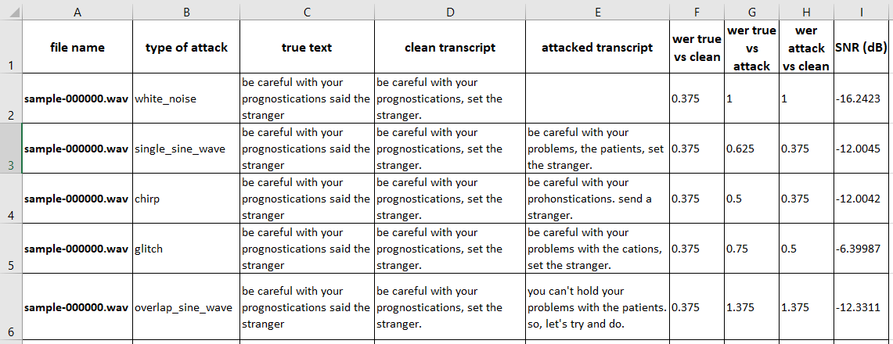
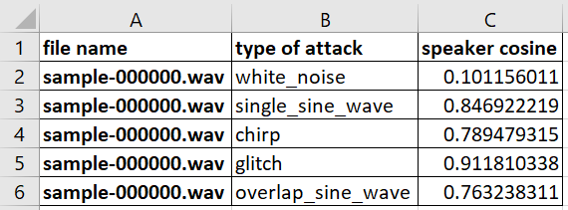
SAMPLE AUDIO FILE
CLEAN VERSION
WITH WHITE NOISE
WITH A SINGLE SINE WAVE
WITH CHIRP
WITH GLITCH
WITH OVERLAPPING SINE WAVES

Slide 22
THANK YOU!

